Slide 1
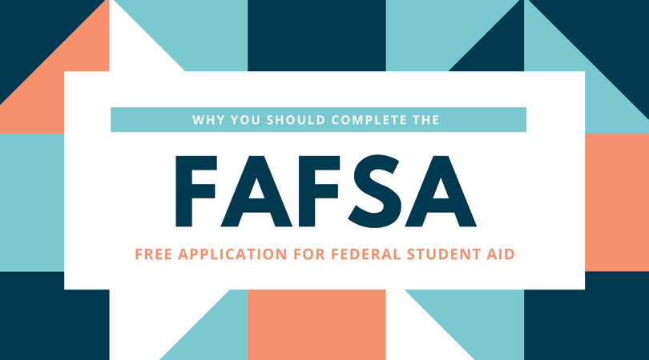
How FAFSA Works - FAQ

Slide 2
What Is the Point of a FAFSA?
The U.S. Department of Education uses the FAFSA application to determine a student's eligibility for need-based federal financial aid for college based upon their financial situation. Federal financial aid may include federal grants, scholarships, work-study, and/or loans.

Slide 3
Is the FAFSA a Loan or Free Money?
The FAFSA application is not a loan. It is simply an application that you fill out in order to determine your eligibility for receiving a federal loan. There are three main types of financial aid that a student may be deemed eligible for after completing a FAFSA application. Some of this money is free money, some must be earned through work, and some must be repaid.

Slide 4
When Should I Fill Out My FAFSA for 2021–2022?
To be considered for federal student aid for the 2021–2022 award year, you can complete a FAFSA form between Oct. 1, 2021, and 11:59 p.m. central time (CT) on June 30, 2022.

Slide 5
The Bottom Line
Most families—regardless of how much they earn or have accumulated in assets—will find it useful to fill out FAFSA. If it turns out that they are ineligible for free money in the form of grants or scholarships, they are still likely to be eligible for non-need-based aid in the form of direct unsubsidized loans from the federal government. Federal student loans typically have more favorable terms than loans from private lenders and offer a variety of flexible repayment options.

